Slide 1
Recommendations to paper presentation at the Sitraer 2022
SITXYZ
Article code
Authors’ name
Institution
Optional logo of your institution in this area

Slide 2
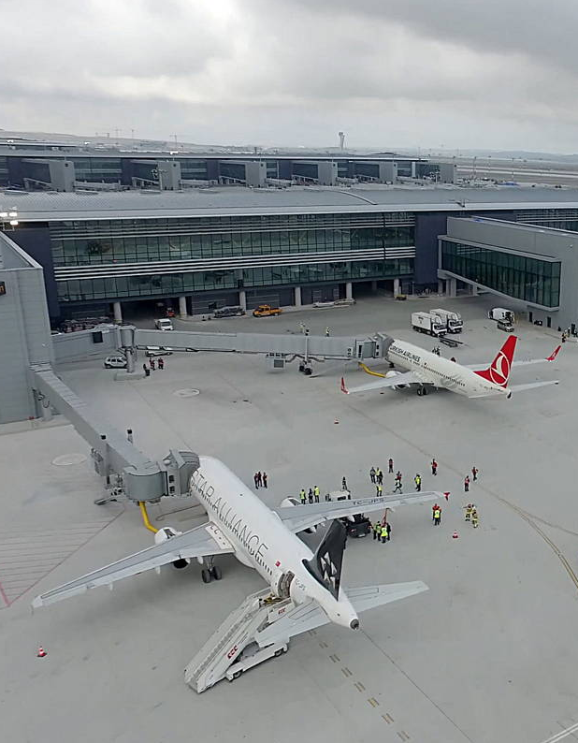
agenda
Optional slide
Font and sizing
Coloring
Figures and tables
Content
Timing

Slide 3
Font sizing for title and text are suggested in order to provide good readability to the audience
Recommendations to paper presentation – Font and sizing
All document may be written using either font Nirmala UI (titles) or Nirmala UI Semilight (text)
Authors must guarantee the readability of the presentation, therefore the suggested font sizing is proposed:
Titles: 24pt
First level text: 18pt
Second level text: 16pt
Third level text or further: 14pt
Caption: 11pt
Authors may highlight text throughout the document with bold, italic, underline or even colors

Slide 4
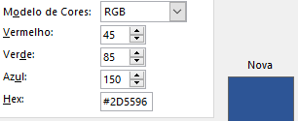
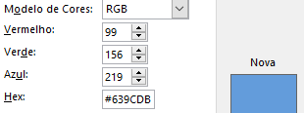
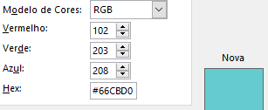
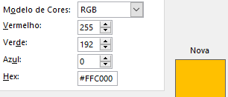
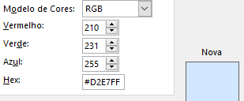
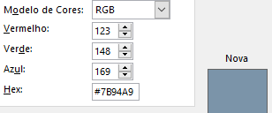
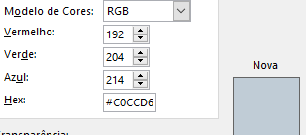
Authors are encouraged to follow the SITRAER 2022 official palette of colors, although it is not mandatory
Recommendations to paper presentation - Coloring

Slide 5
Figures and tables are prone to be part of a presentation. Some examples are provided as follows:
Recommendations to paper presentation – Figures and tables
Numbering, caption and sources are recommended to be presented with all figures and tables
Schemes should follow authors’ preferences as they wish
 | True | False
Output True | 76 | 24
Output False | 12 | 88
Figure 1 Caption of the figure. Source: SITRAER 2022.
Table 1 Caption of the table. Source: SITRAER 2022.

Slide 6
Presentation is expected to cover the main ideas of the article submitted to the event
Recommendations to paper presentation – Content
The presentation content is expected to cover an introduction, a scientific background of the research topic, methodology employed, main results and their implications to the academy and industry
USEFUL TIP
The presentation is about YOUR study:
focus on your results and main ideas.
The audience wants to see and hear from you what all of your efforts have been able to produce, how you achieve them and what can be learnt from them

Slide 7
Use the most from the available slides to build your presentation and to exercise your creativity
Recommendations to paper presentation – Content

Slide 8
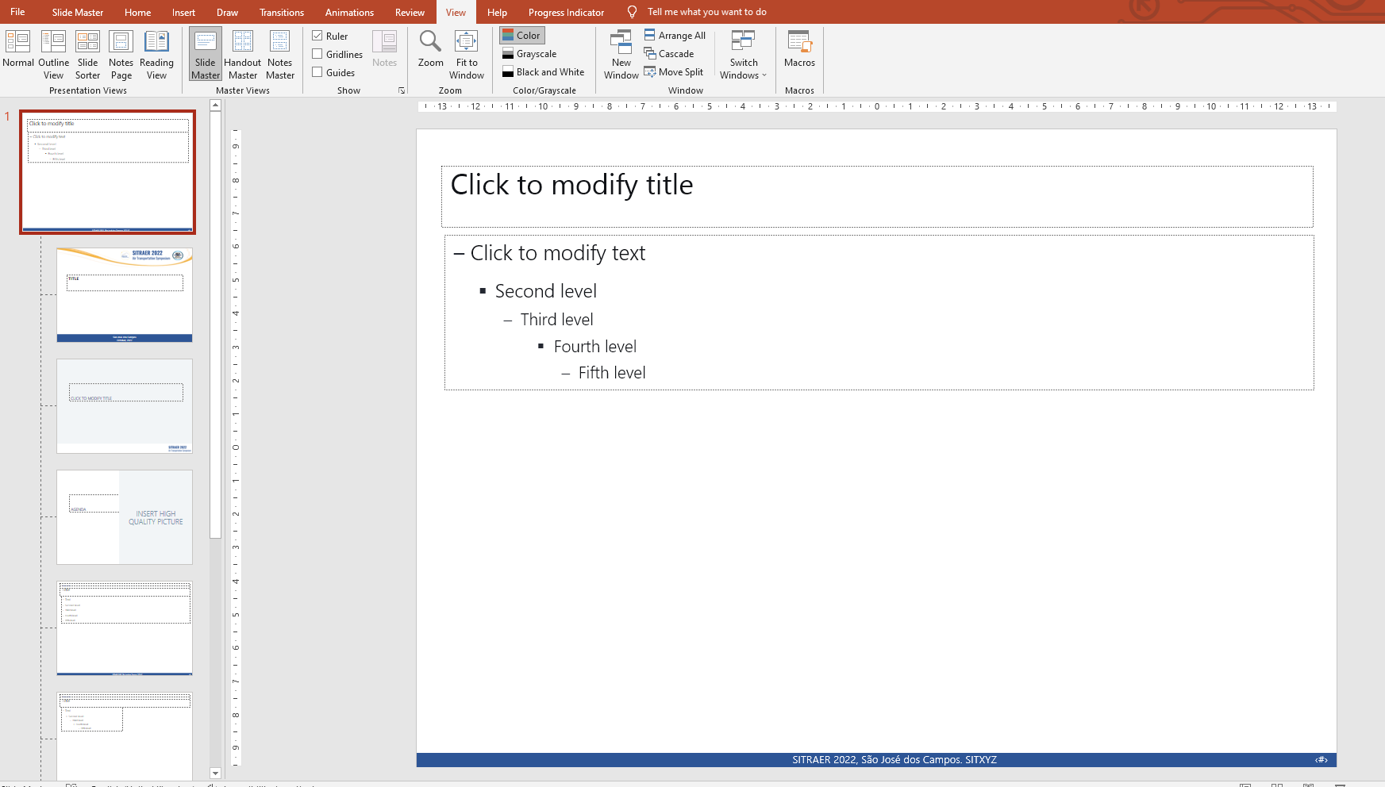
Certify to change your SITXYZ code located at the bottom bar: go to Slide Master editor to do it
Recommendations to paper presentation – Content

Slide 9
Be aware the authors have 15 minutes to complete their speech, besides comments and Q&As
Recommendations to paper presentation – Timing
Comments and questions are not included into the presentation time, however authors may consider them when preparing the document
It is highly encouraged that authors prepare their presentations to be 12-15 minute long at maximum
To accomplish the proposed timing, an adequate presentation is expected to have 10-12 slides
After the presentation, it will be allocated 5 minutes for comments and questions from the audience or the moderator
Certify to remove all notes from this suggestive document before finishing your presentation

Slide 10
We are looking forward to have you
in São José dos Campos for the SITRAER 2022!
The Organizing Committee
sitraer2022@gmail.com

